Slide 1
Bangladesh’s Development Journey
Syed Akhtar Mahmood

Slide 2
The big picture

Slide 3
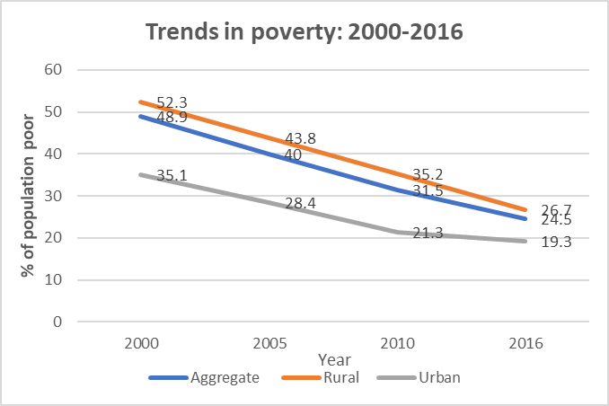
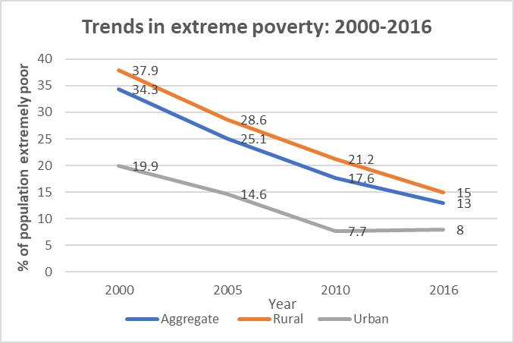
Substantial reduction in poverty
Two very different patterns
  GDP growth rates fluctuated widely in the 1960s and the 1970s
  But the pattern changed from the early 1980s
Since then, there has been a steady increase in GDP with low year-to-year fluctuations
  1980s: fluctuated between 3%-5%
  1990s: remained steady around 5%
  From 2001 onwards: gradually accelerating to reach 8% in 2019
Very few developing countries have experienced such sustained growth rates over four decades
In 2000, one out of two Bangladeshis (49%) were considered poor and about a third was living in extreme poverty
  The situation was slightly worse in rural areas but somewhat better in urban areas.
  In urban Bangladesh, one-third of the population was poor, and one-fifth was extremely poor
The situation has improved significantly since then, with poverty rates steadily falling
  In 2016, about 25% were considered poor compared to almost 50% a decade and a half ago
  The proportion of people living in extreme poverty fell to about 13%, compared to 35% in 2000

Slide 4
An impressive growth record
Two very different patterns
  GDP growth rates fluctuated widely in the 1960s and the 1970s
  But the pattern changed from the early 1980s
Since early 1980s, a steady increase in GDP with low year-to-year fluctuations
  1980s: fluctuated between 3%-5%
  1990s: remained steady around 5%
  From 2001 onwards: gradually accelerating to reach 8% in 2019
Very few developing countries have experienced such sustained growth rates over four decades

Slide 5
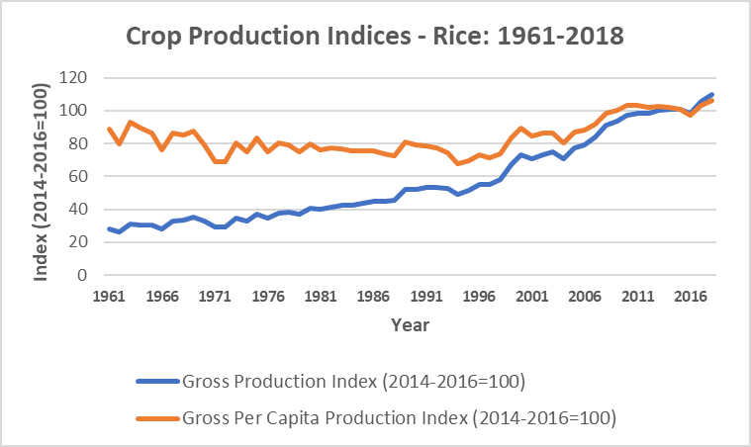
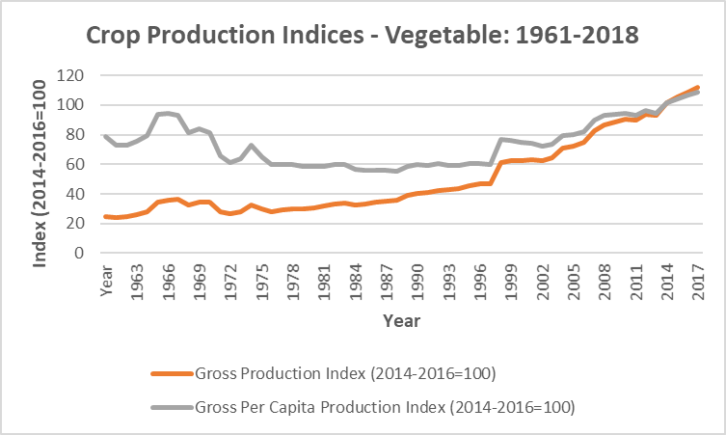
Underpinned by agricultural growth …
Two very different patterns
  GDP growth rates fluctuated widely in the 1960s and the 1970s
  But the pattern changed from the early 1980s
Since then, there has been a steady increase in GDP with low year-to-year fluctuations
  1980s: fluctuated between 3%-5%
  1990s: remained steady around 5%
  From 2001 onwards: gradually accelerating to reach 8% in 2019
Very few developing countries have experienced such sustained growth rates over four decades
The Crop Production Index is a good indicator of developments in the agricultural sector
Here too we see two very different growth regimes
  Early 1960s to late 1990s: A period of steady but moderate growth in the production index
  But this growth lagged population growth, leading to a decline in the per capita index
  From late 1990s to now: A period of accelerating growth, outstripping population growth
  Thus, per capita index also increased
This is true for both rice and vegetable production

Slide 6
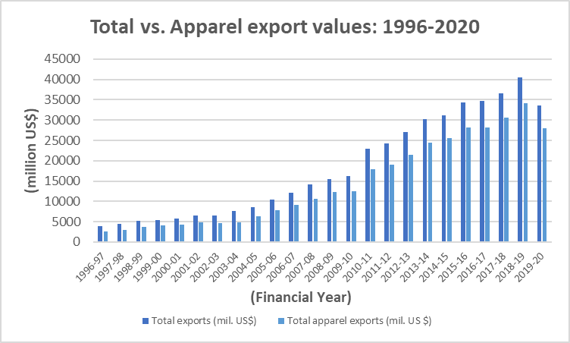
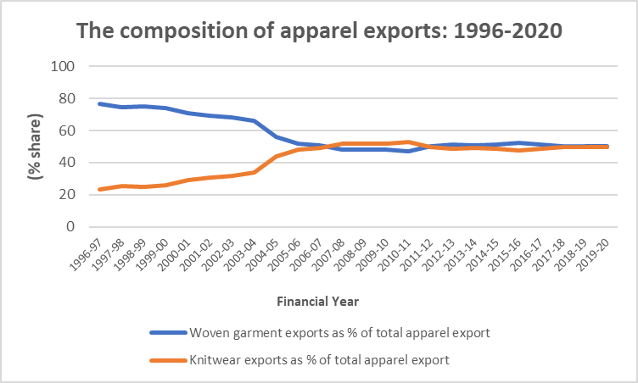
… growth of the garment industry
The most successful manufacturing and export story of Bangladesh
Significant rise in our export earnings in last three decades has been largely due to garment exports
  In the mid-1990s, garments accounted for two-thirds of our export earnings
  Now, garments provide more than 80% of export earnings
The composition of garment exports has changed
  In mid-1990s, 80% of garment export earnings came from woven garments and 20% from knitwear
  Now the shares of these two categories are equal
Nonetheless, only five products account for 75% of garment exports

Slide 7
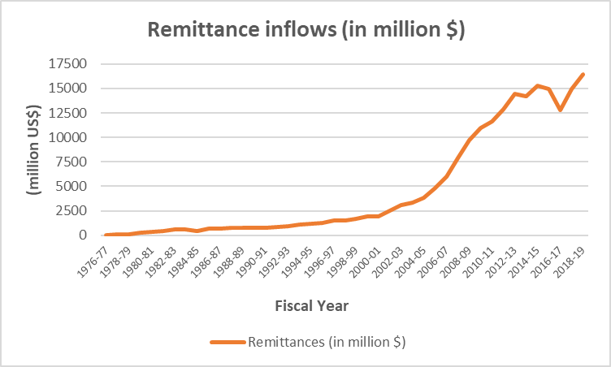
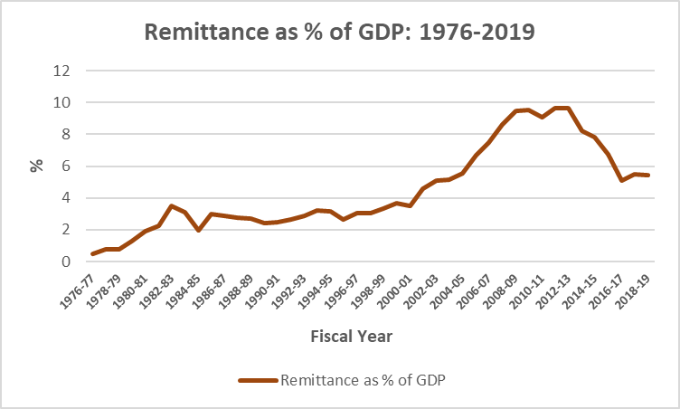
… and remittances
Two very different patterns
  GDP growth rates fluctuated widely in the 1960s and the 1970s
  But the pattern changed from the early 1980s
Since then, there has been a steady increase in GDP with low year-to-year fluctuations
  1980s: fluctuated between 3%-5%
  1990s: remained steady around 5%
  From 2001 onwards: gradually accelerating to reach 8% in 2019
Very few developing countries have experienced such sustained growth rates over four decades
Changing pattern of remittance inflow over time
  Remittances grew at a steady but modest rate from mid-1970s to the end of the 1990s
  It then sharply accelerated from the early 2000s
  However, remittance growth has recently slowed
  Remittances as % of GDP has started declining from 2012 after a sharp rise during the previous decade
Remittances have helped reduce poverty
  In 2016, 8% of households had a family member who had migrated abroad in the previous 5 years
  Remittances not only help increase welfare of recipient families; their spending also boosts local demand
  2000-16: poverty fell faster in districts which had sent more migrants abroad
  Study indicated that if 0.1% of a district’s population migrated abroad, its poverty would fall by 1.7 percent

Slide 8
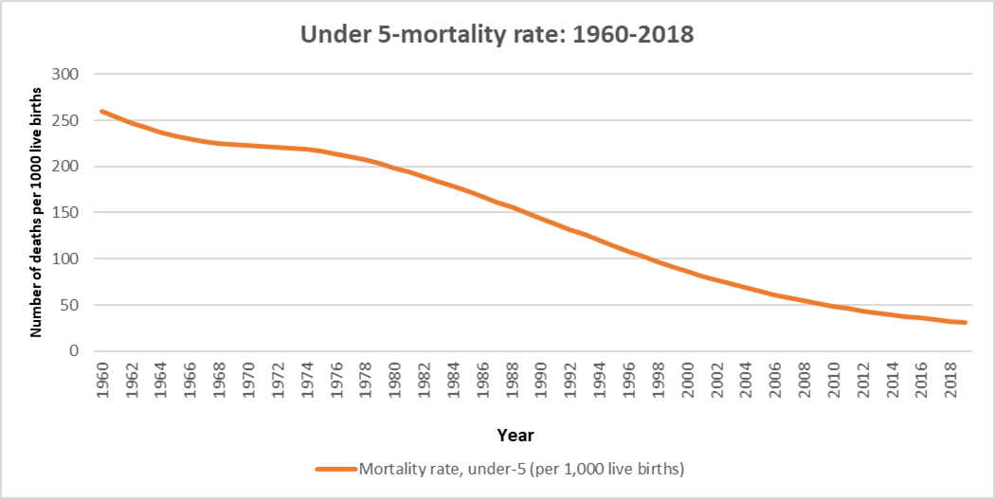
There has also been impressive progress on social indicators
Two very different patterns
  GDP growth rates fluctuated widely in the 1960s and the 1970s
  But the pattern changed from the early 1980s
Since then, there has been a steady increase in GDP with low year-to-year fluctuations
  1980s: fluctuated between 3%-5%
  1990s: remained steady around 5%
  From 2001 onwards: gradually accelerating to reach 8% in 2019
Very few developing countries have experienced such sustained growth rates over four decades
An example is the drop in the under-5 mortality rate
  This was high till the late 1970s
  1 out of every 5 baby would die before its 5th birthday
From the 1980s, this rate started declining sharply
  It was 31 in 2019
  This is below that in Pakistan (67) and India (34)
  But we are way behind Sri Lanka where only 7 out of 1000 babies die before reaching age 5
Life expectancy has gone up, especially for women
  2000: the figure was only slightly higher for women
  2016: now much higher for women (74.3 vs. 70.9)
Fertility rate for women has come down
  From 5 per woman in 1981 to about 2 in 2019

Slide 9
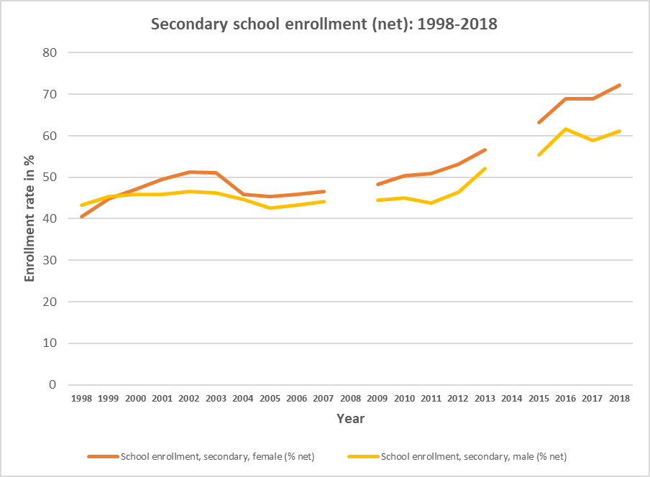
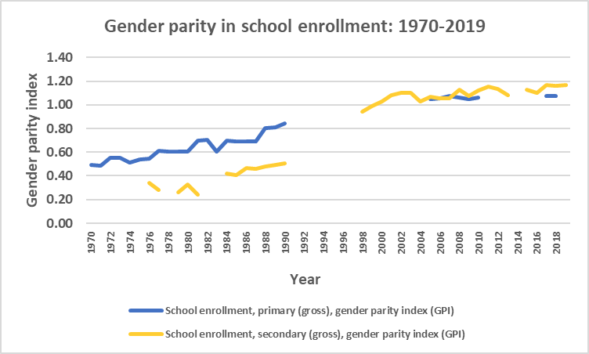
Education attainments are increasing
More children are now attending schools
  2000-2016: net school attendance rates rose by 20% points for primary school and 22% points for secondary
  The investments in children’s education over many years are now translating into a more educated working-age population
Gender gaps are closing
  Gender parity was very low in the 1970s, esp. for secondary enrollment; since then, a steady improvement in gender parity
  Now, girls are more likely to complete primary and secondary schooling than boys
  Adult females are overall less educated than males, but younger generations are reversing this disadvantage.
  However, they still underperform in tertiary schooling
  This has been due to expansion in number of schools, targeted stipends programs for girls, and growth of the RMG industry
Female primary school enrollment rates exceed the average in South Asia and lower-middle income countries
School attendance has grown more rapidly among the poor

Slide 10
Both public and private spending have helped improve educational attainment
Bangladeshi household are spending more on education
  Increases in private spending on education occurred at a faster rate among poor households
  In 2000, the richest 20% of the population spent 22 times more on education than the poorest 20%; in 2016, this had come down to 6 times
Public spending has emphasized investments in the education of poorer children, e.g., through stipend programs and tuition waivers
  In primary schools, about 57 percent of total spending on the median child comes from public resources
  For the median child among the poorest 20%, this share is about 75%
  For secondary schools, on average , 43 percent of spending is public
  But for the secondary school students from the poorest 20 percent of households, the share is 60 percent
These developments have helped to reduce the gap in education spending across socioeconomic groups

Slide 11
Looking behind the headlines

Slide 12
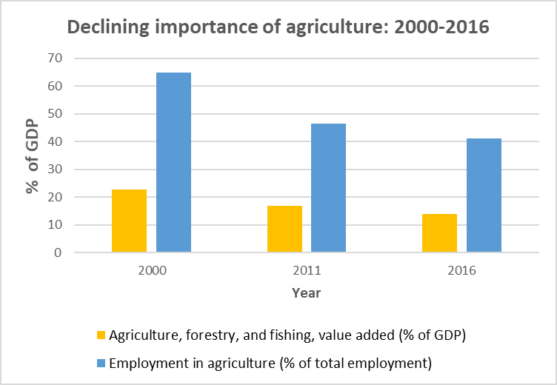
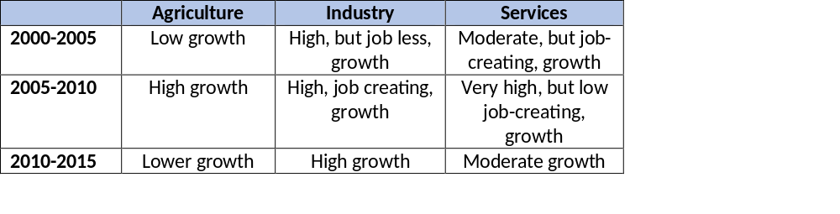
The relative importance of agriculture has gone down
Since 2000, the sectoral composition and geographical focus of economic activity has changed significantly
  Agriculture’s share of GDP has decreased from 23% to 14%
  In 2000, 64% were employed in agriculture, now down to 40%
Growth pattern changed between 2000-05 and 2005-10
  2000-2005: Low average growth in agriculture, high but jobless growth in industry, and moderate, job-creating growth in services
  2005-2010: High growth in agriculture, high job-creating growth in industry, and very high, but low job creating, growth in services. Start of Bangladesh’s boom in the creation of manufacturing jobs
  2010 to 2016: Lower agricultural growth, high growth in manufacturing, and moderate service sector growth
These had implications for poverty reduction
  Poverty reduction in 2000-2005 was driven by the service sector In 2005-2010, by high agricultural growth, in 2010-2016 by rural non-farm growth
Two very different patterns
  GDP growth rates fluctuated widely in the 1960s and the 1970s
  But the pattern changed from the early 1980s
Since then, there has been a steady increase in GDP with low year-to-year fluctuations
  1980s: fluctuated between 3%-5%
  1990s: remained steady around 5%
  From 2001 onwards: gradually accelerating to reach 8% in 2019
Very few developing countries have experienced such sustained growth rates over four decades

Slide 13
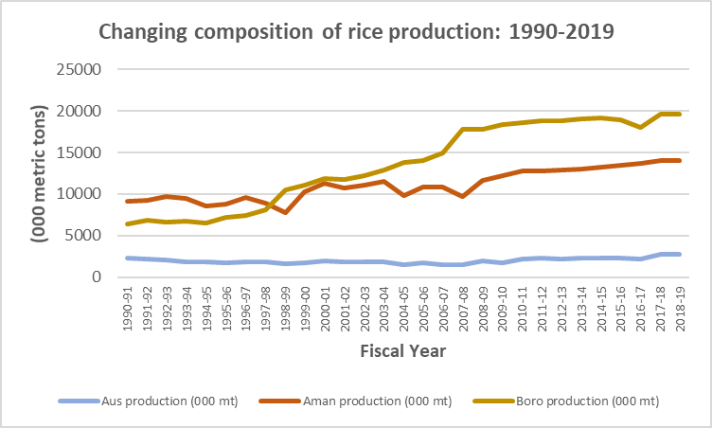
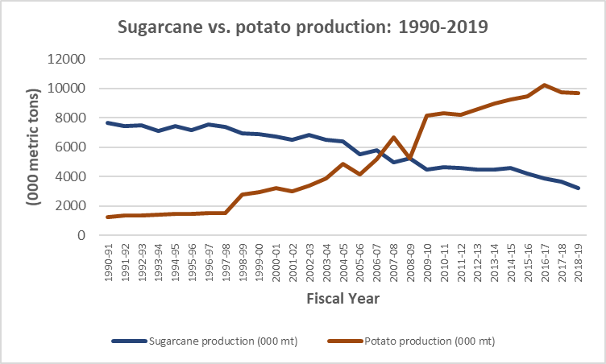
Composition of agricultural production has changed
Boro has emerged as the most important rice crop
  In 1990/91, Boro production was 6.3 million metric tons. This was about three times that of Aus (2.3 million MT) but less than that of Aman (9.2 million MT)
  Aus production has not increased much in the last three decades while Aman has increased by about 50%
  However, Boro production has increased more than three times during this period
There have been other changes too in the composition of agricultural production
  Some traditionally important products have gone down in importance while others have emerged as important products
  For example, sugarcane was an important crop in the 1990s while potato was much less important
  But the roles have now been reversed as sugar production has declined over time while potato output has increased sharply
Two very different patterns
  GDP growth rates fluctuated widely in the 1960s and the 1970s
  But the pattern changed from the early 1980s
Since then, there has been a steady increase in GDP with low year-to-year fluctuations
  1980s: fluctuated between 3%-5%
  1990s: remained steady around 5%
  From 2001 onwards: gradually accelerating to reach 8% in 2019
Very few developing countries have experienced such sustained growth rates over four decades

Slide 14
Rural nonfarm activities have expanded
Rural non-farm activities now an important source of income for rural people
  In 2010, almost half (47%) of all rural households were primarily engaged in agriculture.
  By 2016, this proportion had fallen to one-fourth (27%)
Thus, it is now a major driver of rural poverty reduction
  2005-2010: 69 percent of rural poverty reduction was among households primarily engaged in agriculture
  2010-2016: 59 percent was among households whose primary sector of employment was industry or services
  Households with higher shares of non-farm income were less likely to remain in or fall into poverty
Two very different patterns
  GDP growth rates fluctuated widely in the 1960s and the 1970s
  But the pattern changed from the early 1980s
Since then, there has been a steady increase in GDP with low year-to-year fluctuations
  1980s: fluctuated between 3%-5%
  1990s: remained steady around 5%
  From 2001 onwards: gradually accelerating to reach 8% in 2019
Very few developing countries have experienced such sustained growth rates over four decades

Slide 15
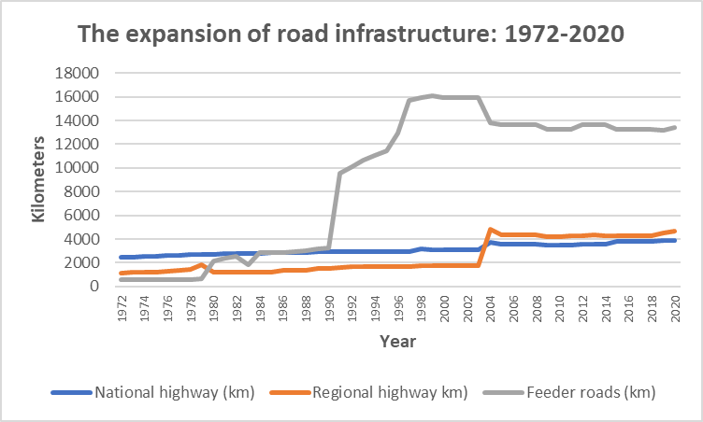
Road connectivity has expanded considerably
The national and regional highway network has expanded at a modest rate since independence
  The national highways link Dhaka to the divisional capitals and the capitals of the old districts
  The regional highways connect the old district capitals to the new district and upazilla towns
  These networks together have expanded from 3609 kms to 8613 kms during 1972-2010; i.e., by only 104 kms. each year
However, the feeder roads have seen a huge expansion
  These link district & upazilla towns to villages and smaller towns
  The network had a huge growth spurt during the 1990s; expanding from 3245 kms. to almost 16000 kms in 10 years
  It has shrunk a bit after 2000 but remains significant
The huge expansion of the feeder roads have substantially increased rural connectivity with the rest of the country

Slide 16
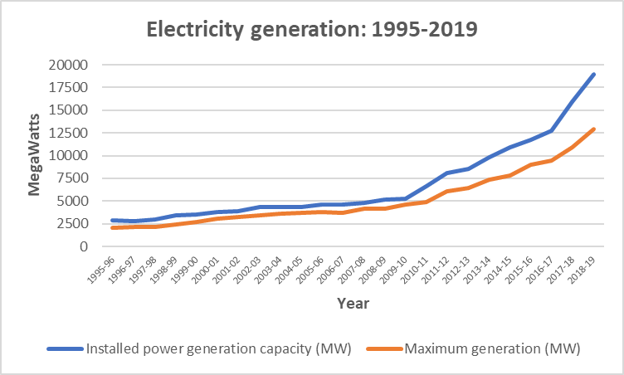
More people now have access to electricity
Electricity generation capacity increased at a modest rate between 1995/96 and 2009/10
  It increased from 2908 MW to 5271 MW
  This is an average increase of about 170 MW per year
The rate accelerated after 2010
  About 14000 MW capacity was added during 2010/11 – 2018/19, bringing total installed capacity to almost 19000 MW by end of 2018/19.
  This is an average increase of 1521 MW per year, i.e., almost 9 times higher than in the preceding decade and a half.
Leading to a significant increase in access to electricity
  Three-fourths of Bangladeshis now have access to electricity, compared to one-third in 2000
  The increase is particularly significant for rural Bangladeshis – from 17% to 66% over the same period
Two very different patterns
  GDP growth rates fluctuated widely in the 1960s and the 1970s
  But the pattern changed from the early 1980s
Since then, there has been a steady increase in GDP with low year-to-year fluctuations
  1980s: fluctuated between 3%-5%
  1990s: remained steady around 5%
  From 2001 onwards: gradually accelerating tveloping countries have experienced such sustained growth rates over four decades

Slide 17
No scope for complacency

Slide 18
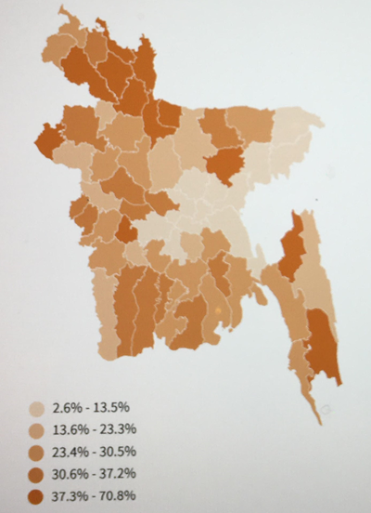
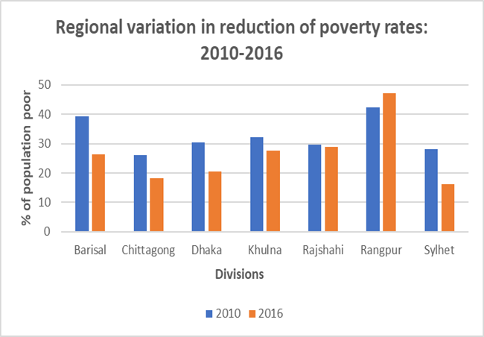
Uneven reduction in poverty across Bangladesh
Wide regional variation in incidence of poverty
  Poverty remains high in northern Bangladesh and some parts of western and southern Bangladesh
Also differences in rate of poverty reduction over time
  For example, the poverty rate increased in the Rangpur division during 2010-16 although it decreased in the rest of the country
  Rangpur was already the poorest division in the country in 2010; it has become even more in 2016
  However, poverty dropped substantially in Barisal. It was second poorest division in 2010; in 2016 it was the fourth poorest.
Differences between the eastern and western regions of Bangladesh has now widened
  This reverses the trend during 2005-2010 when the difference had narrowed
  The re-emerging divergence between the East and West has occurred largely in rural, instead of urban areas
The gains in rural areas were not uniform: the rural West recorded slower progress on education and demographic change, contributing to the re-emergent East-West divide.
Two very different patterns
  GDP growth rates fluctuated widely in the 1960s and the 1970s
  But the pattern changed from the early 1980s
Since then, there has been a steady increase in GDP with low year-to-year fluctuations
  1980s: fluctuated between 3%-5%
  1990s: remained steady around 5%
  From 2001 onwards: gradually accelerating to reach 8% in 2019
Very few developing countries have experienced such sustained growth rates over four decades

Slide 19
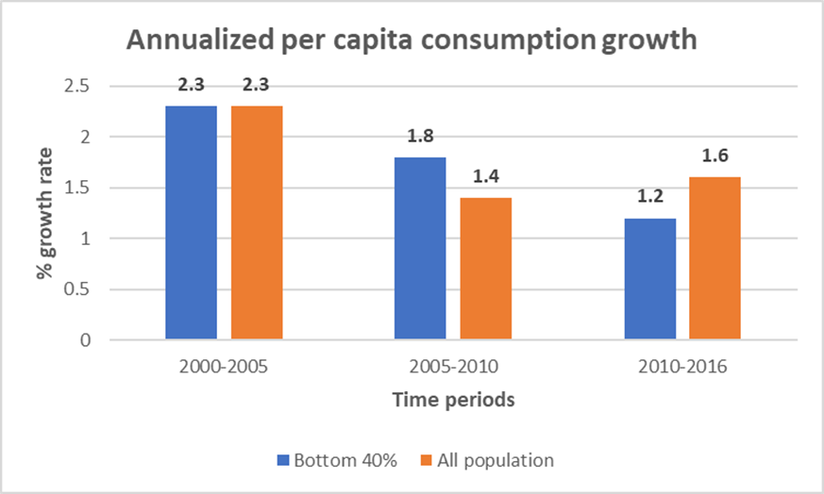
Vulnerability remains high; inequality is rising
Two very different patterns
  GDP growth rates fluctuated widely in the 1960s and the 1970s
  But the pattern changed from the early 1980s
Since then, there has been a steady increase in GDP with low year-to-year fluctuations
  1980s: fluctuated between 3%-5%
  1990s: remained steady around 5%
  From 2001 onwards: gradually accelerating to reach 8% in 2019
Very few developing countries have experienced such sustained growth rates over four decades
Although poverty has gone down, the share of vulnerable people, i.e., those who may become poor again, is high and increasing
  In 2000, it was 40%
  In 2016, it rose to 50%
Consumption growth has slowed and become more unequal
  During 2000-05, the average consumption level of Bangladeshis increased by 2.3% each year; during 2010-2016, this rate came down to 1.6%
  The average consumption level of the poorest 40% of the population was the same as the national average during 2000-2005
  But, during 2010-2016, their consumption growth rate was slower than the national average; 1.2% annually vs. 1.65

